Slide 1

Машинное Обучение
Лекция 3.02
В которой мы попытаемся обсудим нейронки для табличных данных
(конкретные архитектуры - статьи будем читать, ура)
Долганов Антон Юрьевич

Slide 2

В предыдущей серии
.
Табличные данные
Не такие как другие
Недостатки стали плюсами и наоборот (
Про нейронные сети
Полносвязный слои (ок) и Свёрточные слои (не ок)
Слои Embedding (топ за свои деньги для категорий)
Про табличные методы в обработке картинок / текста
Используем готовые модели для генерации признаков
Gensim (для Word2Vec подобного)
Готовые модели CNN (как в TensorFlow, так и в PyTorch)
Hugging Face (на выбор много моделей, явно среди этого есть что-то хорошее)

Slide 3
Содержание
.
Про нейронные сети для табличек

Slide 4
Спросим у великой компьютеры
.
Based on the sources provided, the most popular neural network architectures for tabular data processing are:
1. **TabTransformer**: A Transformer-based architecture for processing categorical features and MLP for final prediction.
2. **TabNet**: A neural network architecture that uses a sequential attention mechanism to select the most relevant features for each prediction task.
3. **SAINT**: A neural network architecture that uses a sparse attention mechanism to select a subset of the most relevant features for each prediction task.
4. **FT-Transformer**: A Transformer-based architecture that uses a feature tokenizer and transformer to process tabular data.
5. **DANETs**: A deep abstract network for tabular data classification and regression.
6. **Hopular**: A modern Hopfield network for tabular data.
7. **GATE**: A gated additive tree ensemble for tabular classification and regression.
8. **TabPFN**: A Transformer-based architecture that solves small tabular classification problems in a second.
These architectures are designed to handle the unique challenges of tabular data, such as mixed data types, categorical variables, and high-cardinality features. They use various techniques such as attention mechanisms, feature embeddings, and sparse attention to improve the performance and interpretability of the models.
https://firiuza.medium.com/deep-neural-networks-for-tabular-data-b0495c167c8
https://arxiv.org/pdf/2110.01889
https://jeande.medium.com/the-ultimate-guide-on-choosing-the-right-neural-network-architecture-for-the-right-data-e6dac305836e
https://sebastianraschka.com/blog/2022/deep-learning-for-tabular-data.html

Slide 5
Содержание
.
Про нейронные сети для табличек
FT-Transformer

Slide 6

FT-Transformer
.
MLP (Multi-Layer Perceptron)
MLP(x) = Linear (MLPBlock (. . .(MLPBlock(x))))
MLPBlock(x) = Dropout(ReLU(Linear(x)))
ResNet (тот самый)
$$\text{ResNet}\text{(}\text{x}\text{) = }\text{Prediction}\text{ (}\text{ResNetBlock}\text{ (. . .(}\text{ResNetBlock}\text{ (}\text{Linear}\text{(}\text{x}\text{))))) }$$
$$\text{ResNetBlock}\text{(}\text{x}\text{) = }\text{x}\text{ + }\text{Dropout}\text{(}\text{Linear}\text{(}\text{Dropout}\text{(}\text{ReLU}\text{(}\text{Linear}\text{(}\text{BatchNorm}\text{(}\text{x}\text{)))))) }$$
$$\text{Prediction}\text{(}\text{x}\text{) = }\text{Linear}\text{ (}\text{ReLU}\text{ (}\text{BatchNorm}\text{ (}\text{x}\text{)))}$$
Gorishniy, Yury, et al. "Revisiting deep learning models for tabular data." Advances in Neural Information Processing Systems 34 (2021): 18932-18943.
https://arxiv.org/pdf/2106.11959

Slide 7
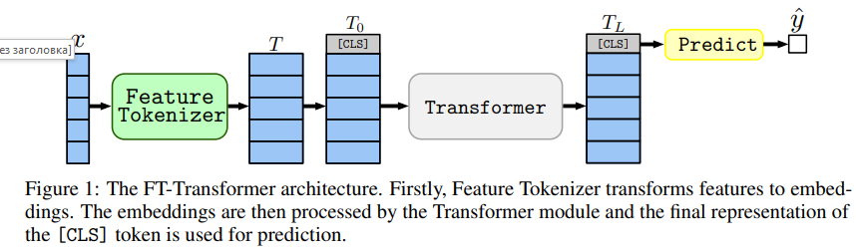
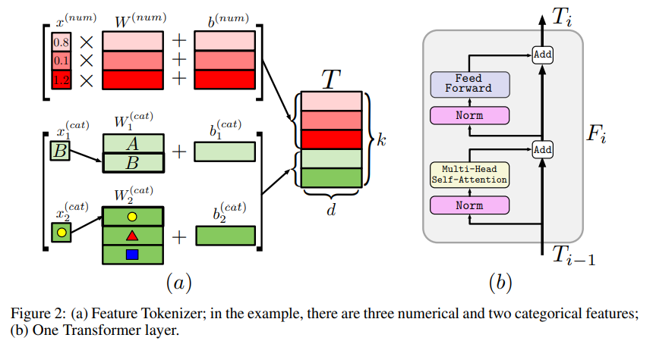


FT-Transformer
.
FT-Transformer
$$T_{j}^{num}=b_{j}^{num}+x_{j}^{num}∙W_{j}^{num}$$
$$T_{j}^{cat}=b_{j}^{cat}+e_{j}^{T}∙W_{j}^{cat}$$
Gorishniy, Yury, et al. "Revisiting deep learning models for tabular data." Advances in Neural Information Processing Systems 34 (2021): 18932-18943.
https://arxiv.org/pdf/2106.11959

Slide 8
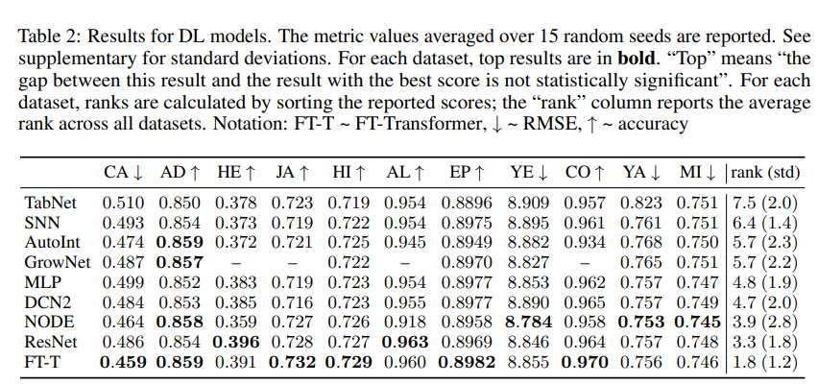
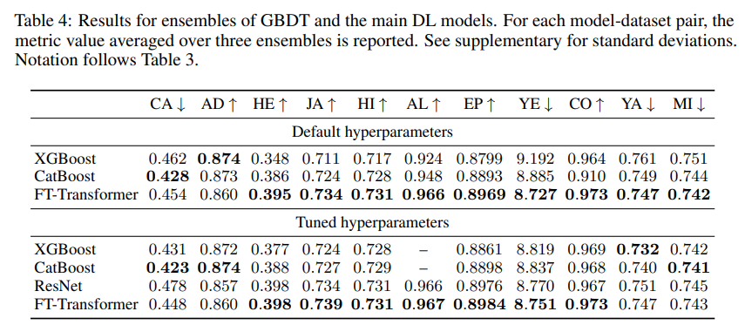
FT-Transformer
.
Gorishniy, Yury, et al. "Revisiting deep learning models for tabular data." Advances in Neural Information Processing Systems 34 (2021): 18932-18943.
https://arxiv.org/pdf/2106.11959

Slide 9
Содержание
.
Про нейронные сети для табличек
SAINT

Slide 10
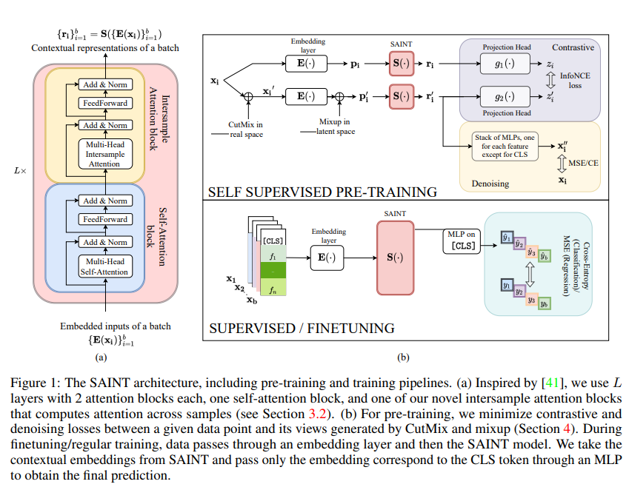
SAINT
.
Somepalli, Gowthami, et al. "Saint: Improved neural networks for tabular data via row attention and contrastive pre-training." arXiv preprint arXiv:2106.01342 (2021).
https://arxiv.org/pdf/2106.01342

Slide 11
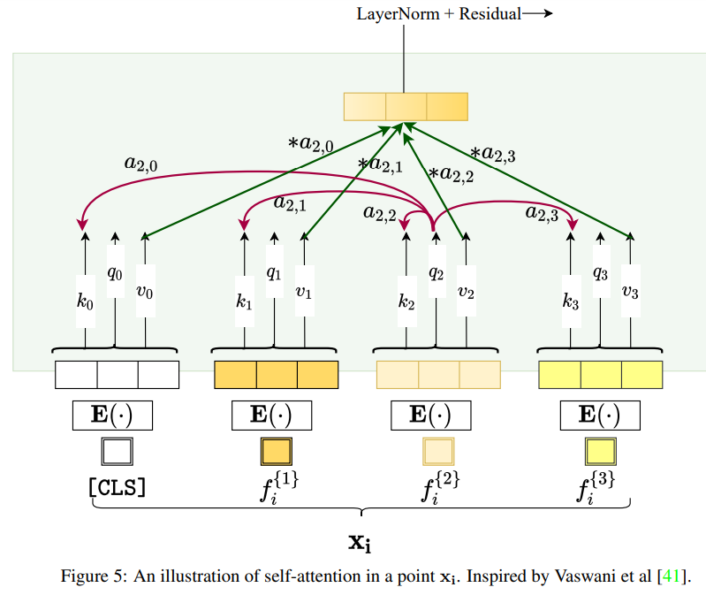
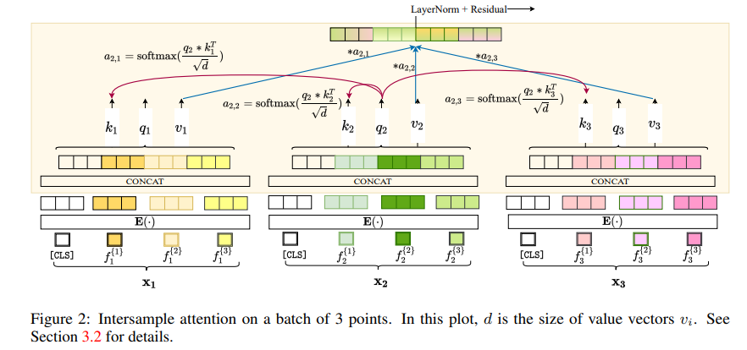
SAINT
.
Somepalli, Gowthami, et al. "Saint: Improved neural networks for tabular data via row attention and contrastive pre-training." arXiv preprint arXiv:2106.01342 (2021).
https://arxiv.org/pdf/2106.01342

Slide 12
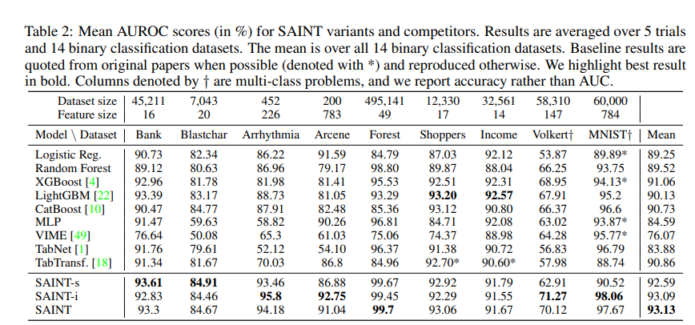
SAINT
.
Somepalli, Gowthami, et al. "Saint: Improved neural networks for tabular data via row attention and contrastive pre-training." arXiv preprint arXiv:2106.01342 (2021).
https://arxiv.org/pdf/2106.01342

Slide 13
Содержание
.
Про нейронные сети для табличек
TabTransformer

Slide 14
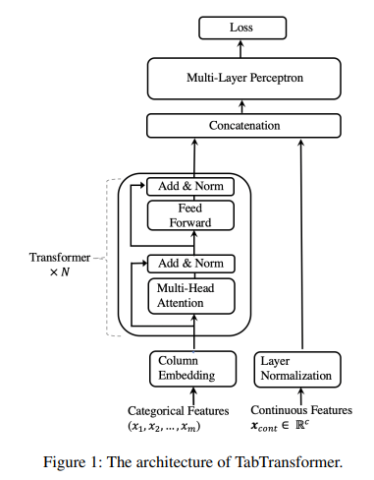
TabTransformer
.
Huang, Xin, et al. "Tabtransformer: Tabular data modeling using contextual embeddings." arXiv preprint arXiv:2012.06678 (2020).
https://arxiv.org/pdf/2012.06678

Slide 15
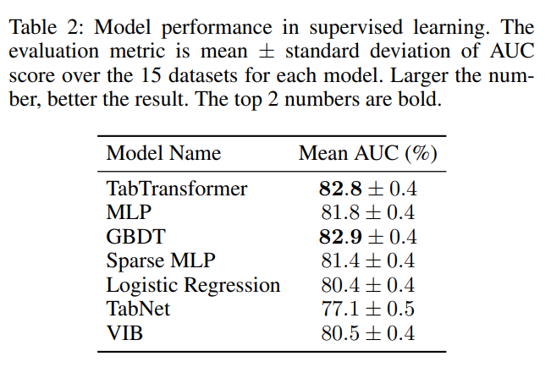
TabTransformer
.
Huang, Xin, et al. "Tabtransformer: Tabular data modeling using contextual embeddings." arXiv preprint arXiv:2012.06678 (2020).
https://arxiv.org/pdf/2012.06678

Slide 16
Содержание
.
Про нейронные сети для табличек
TabNet

Slide 17
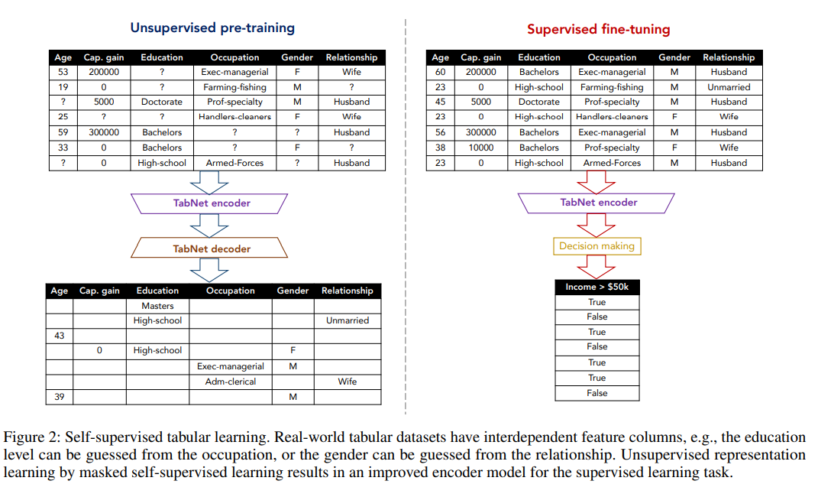
TabNet
.
Arik, Sercan Ö., and Tomas Pfister. "Tabnet: Attentive interpretable tabular learning." Proceedings of the AAAI conference on artificial intelligence. Vol. 35. No. 8. 2021.
https://arxiv.org/pdf/1908.07442

Slide 18
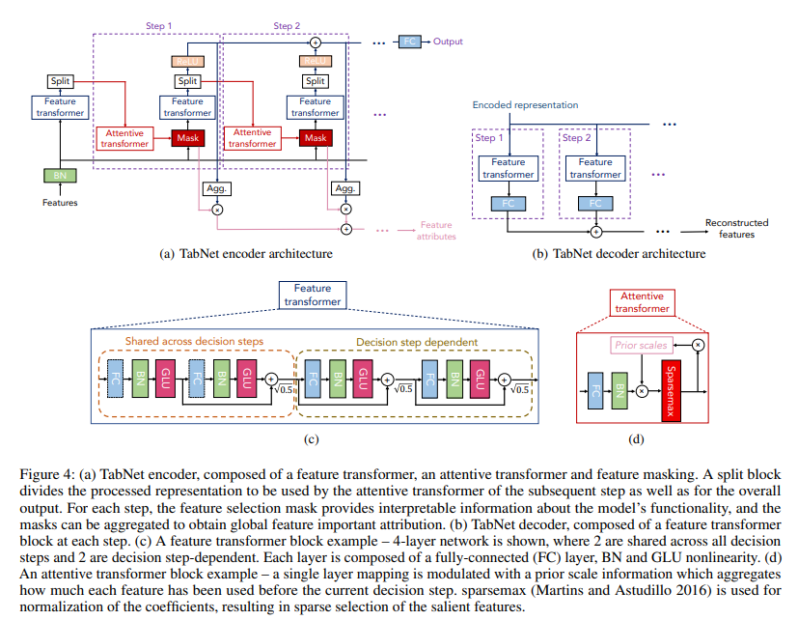
TabNet
.
Arik, Sercan Ö., and Tomas Pfister. "Tabnet: Attentive interpretable tabular learning." Proceedings of the AAAI conference on artificial intelligence. Vol. 35. No. 8. 2021.
https://arxiv.org/pdf/1908.07442

Slide 19
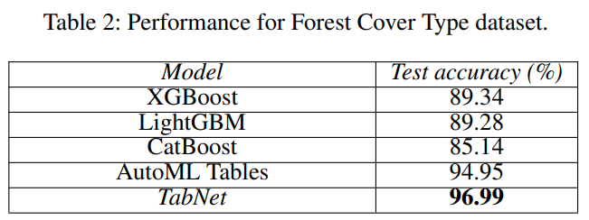
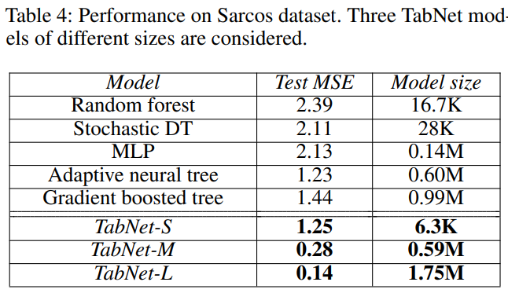
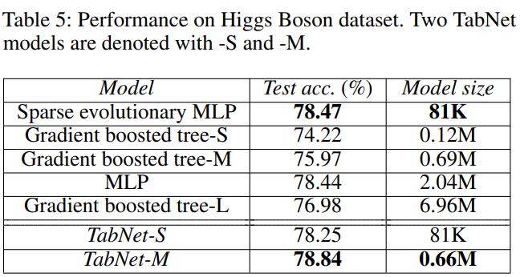
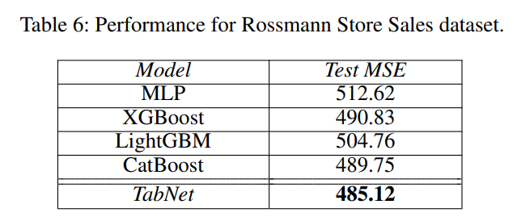
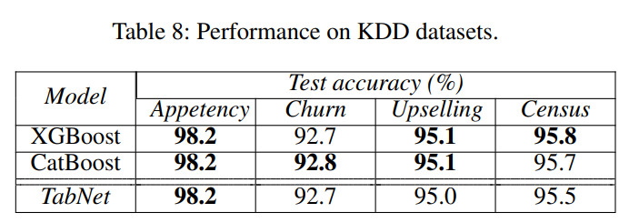
TabNet
.
Arik, Sercan Ö., and Tomas Pfister. "Tabnet: Attentive interpretable tabular learning." Proceedings of the AAAI conference on artificial intelligence. Vol. 35. No. 8. 2021.
https://arxiv.org/pdf/1908.07442

Slide 20
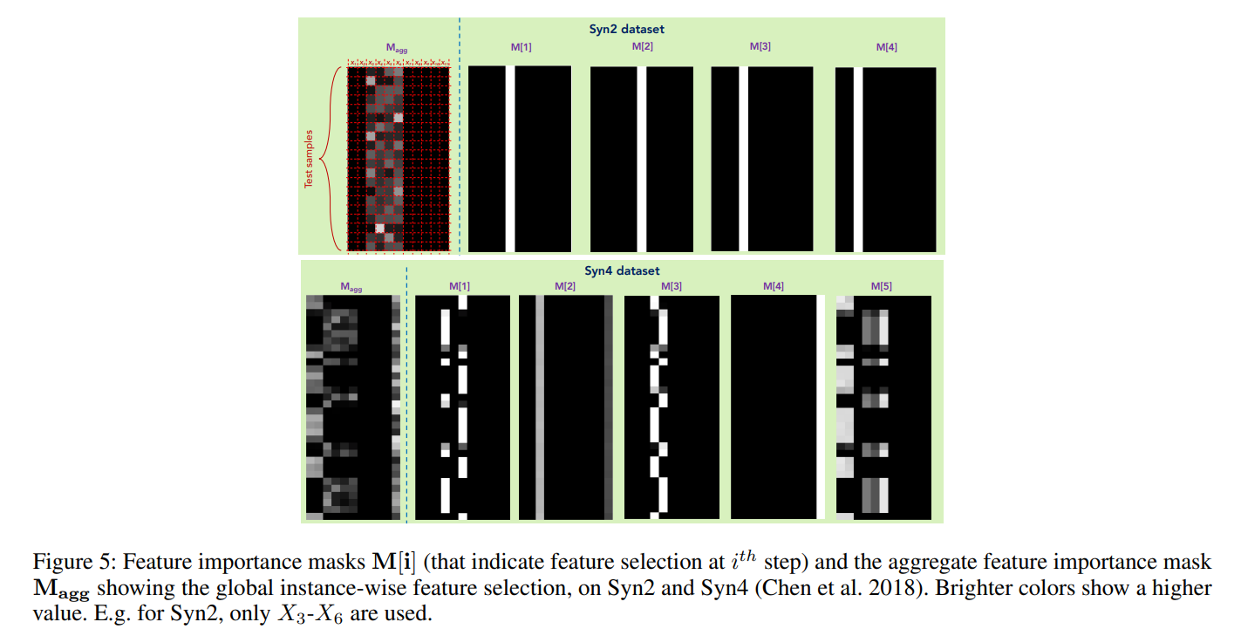
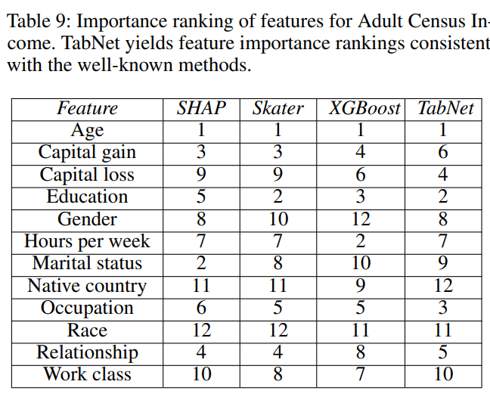
TabNet
.
Arik, Sercan Ö., and Tomas Pfister. "Tabnet: Attentive interpretable tabular learning." Proceedings of the AAAI conference on artificial intelligence. Vol. 35. No. 8. 2021.
https://arxiv.org/pdf/1908.07442

Slide 21
Резюме
.
Про нейронные сети для табличек
Есть много вариантов на основе трансформеров
Но смысл без полезных признаков

Slide 22
Про нейронки и таблички - Архитектуры. Антон Долганов
.
Вопросы, пожелания, предложения
?????????

